Slide 1
Zoom Training
College of Central Florida
Smokie West
wests@cf.edu

Slide 2
What is Zoom?
Zoom is a Cloud-based application that is capable of integrating video conferencing and instant messaging solutions in one location
Zoom is a popular application for educations, employers, employees, and students across the globe
Zoom can be used for personal meetings without a cost or for professional use with monthly/annual fees

Slide 3
What are the Benefits of Zoom?
Zoom works with Outlook for scheduling
Zoom is capable of being integrated into Canvas for faculty to conduct live meetings with students that is embedded into their course
Zoom meetings can be created and accessed through a web browser, the application, or desktop client
Invited attendees can connect to a Zoom meeting through their smart devices or by calling the number listed in the invitation

Slide 4
Before we get started
For those participating via video, please see the below arrows to control your experience
Notes:
As a participant, please be sure to mute your audio, which is at the bottom left of your screen. You are able to control whether we see you and your surroundings during the Zoom session by clicking to either show or hide your video. All video attendees, please click participants and the chat options so you are able to see questions others may have and activate some additional tools. The share screen option is an amazing tool that can be used with any meeting.

Slide 5
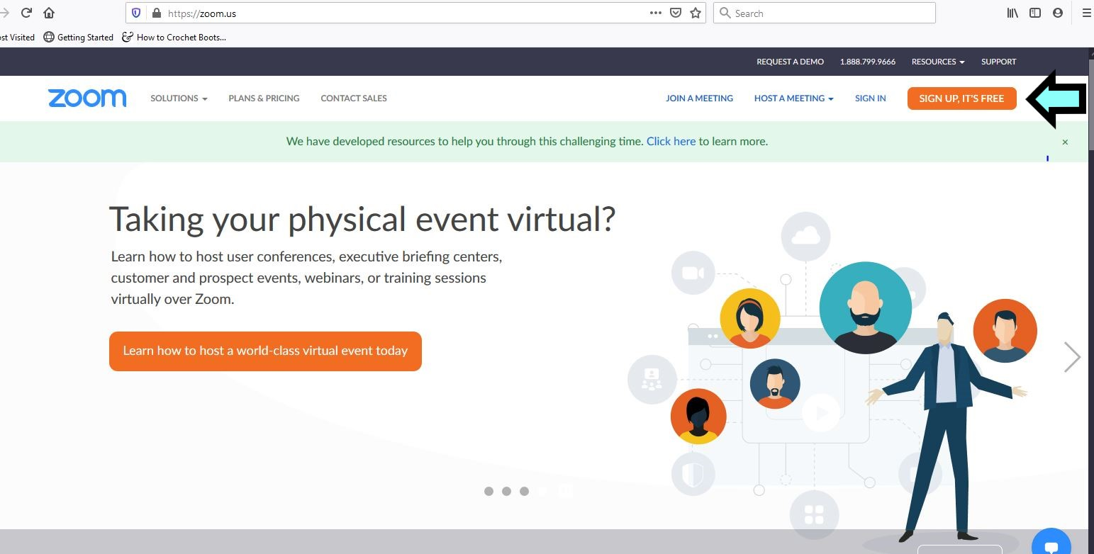
How to Create a Zoom Account
Follow the link sent to your CF email account
If you have not received a link, email Josh Strigle at striglej@cf.edu or DLhelp@cf.edu
Getting Started With Zoom
PDF Document

Slide 6
How to Create a Zoom Account (Con’t)
Enter your date of birth
Enter your CF email address
Click on the link in the activation email
Enter your first name, last name, and password
Check the box for reCaptcha
Download Zoom onto your desktop from the link or your smart device through your app store
Notes:
https://www.bates.edu/helpdesk/2020/03/23/how-to-zoom-downloading-and-installing-the-zoom-application-prior-to-your-first-zoom-meeting/

Slide 7
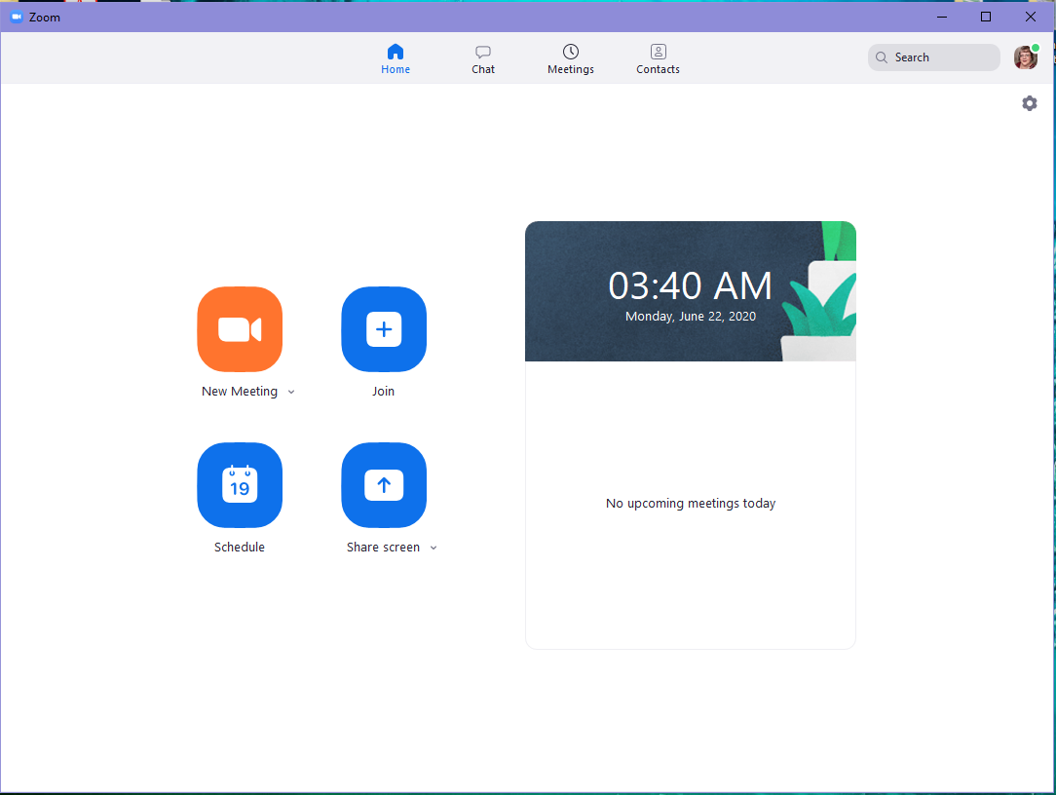
Creating a Zoom meeting
The meeting can be created from your web account, desktop icon, or mobile app
From the desktop icon or app,
click on “Schedule”
Select your settings
Send the invitation via Outlook or
your CF email address

Slide 8
Scheduling Example
Change the topic to the most relevant title
Set the date and time
Select the duration (options in 15 minute intervals)
Check “Require meeting password” if not selected
Select video on for host and participants
If you have your CF email synced to Outlook, you can have Outlook email the invitation and place it on your calendar
Check “Enable Waiting Room”
Check “Mute participants upon entry”
Note: You are able to “Automatically record meeting,” if you will be saving the meeting or sharing it
The last option (not shown) is to list your alternative hosts

Slide 9
Settings for Zoom Meetings
Safety should always be at the forefront of your mind, especially when potentially dealing with confidential information or documents
Set every meeting to have a unique meeting date and time, even if recurring
Always require a password for entry
Do not allow participants to enter the room before you, except your co-host/alternative host
Enable the waiting room for each session
Limit screen sharing, unless you are in a one-on-one session or using a co-host or alternative host
Mute all participants upon entry to limit background noise
Notes:
Image from https://pixabay.com/images/search/security/

Slide 10
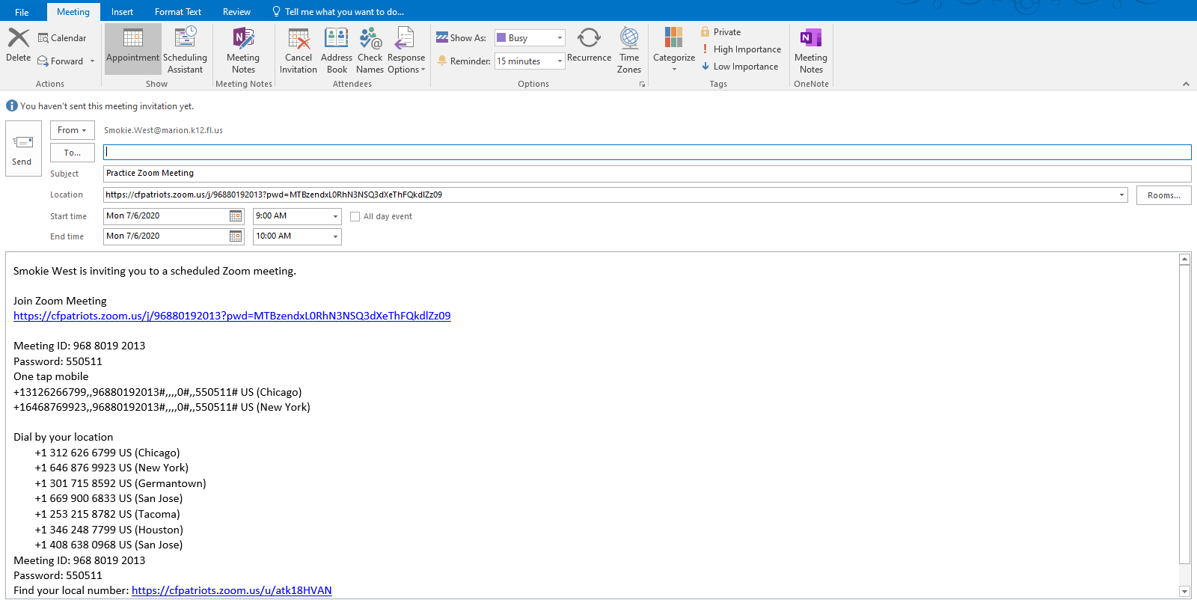
Sending the Meeting Invitation
If you have Outlook set up on your computer, it will create the invitation automatically
Simply type in the email address of the recipients and hit send
The link, meeting ID, password, and phone numbers automatically generate to your email

Slide 11
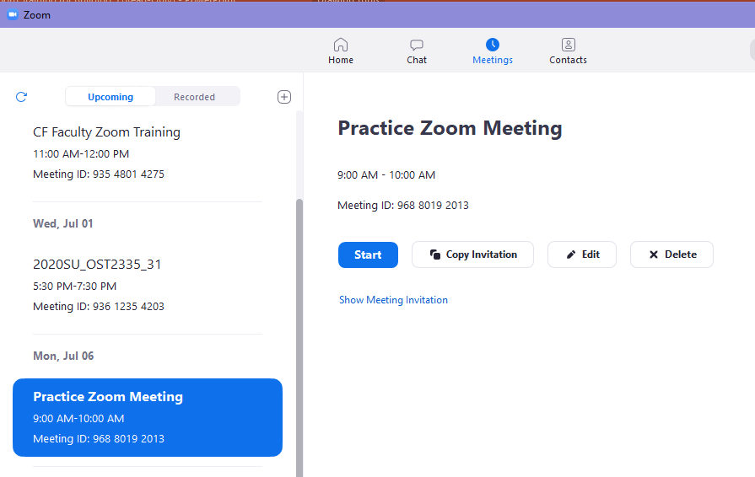
Sending the Meeting Invitation
If you do not have Outlook set up on your computer or choose to send through another source (e.g.: Canvas), you will need to copy the invitation
Click on the “Meetings” tab from the desktop, app, or web browser
Click on the specific meeting you want to send out and click “Copy Invitation”
The link, meeting ID, password, and phone numbers automatically copy to your clipboard so you are able to paste them to your email or message
Notes:
You may also click on “Show Meeting Invitation,” select all of the text, copy, and paste it to your message.

Slide 12
Participant Engagement
How do we engage our participants in the Zoom process?
Participants are able to use voting options (yes/no), thumbs up emojis, applause emojis, requests for the speaker to “go slower” or “go faster,” and a coffee cup signifying they need a break
Zoom Group Chat allows participants to send information to everyone in the group or a specific individual
In your settings, you can show up to 49 participants stacked as your default
Why should we encourage engagement?
Engagement encourages interaction and content retention
It allows participants to ask questions

Slide 13
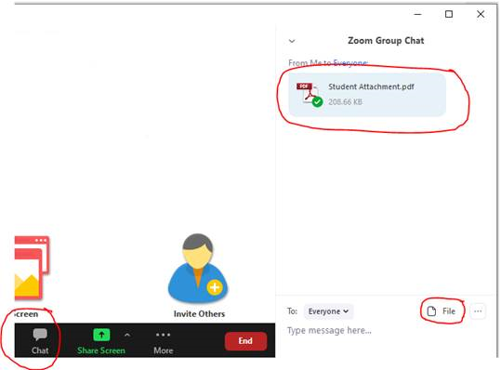
How to accept a document through Zoom
If students wish to use their smart phones, they can take pictures
of any documents you require and email them to you.
If students have electronic documents to submit, they
can again either email them to you, or attach
them directly in the zoom meeting.

Slide 14
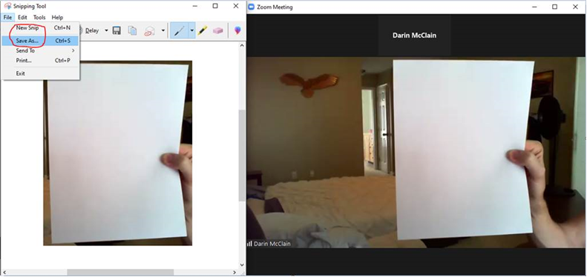
How to accept a document through Zoom (con’t)
Another option would have the student(s) hold up any documents in
front of the camera to be captured by you. Using the sniping tool,
create a picture that
can be saved as a file.
Be careful as clarity of the
document could be an issue
using this option.

Slide 15
Settings Through Zoom site
We are going to take a virtual tour of the advanced settings within Zoom that will allow you to enhance your experience
Zoom Sign In Link

Slide 16
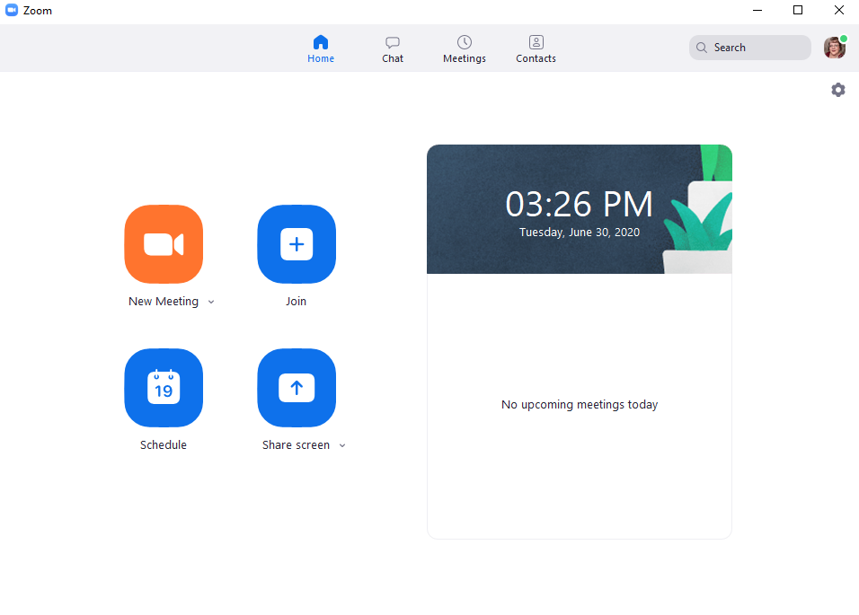
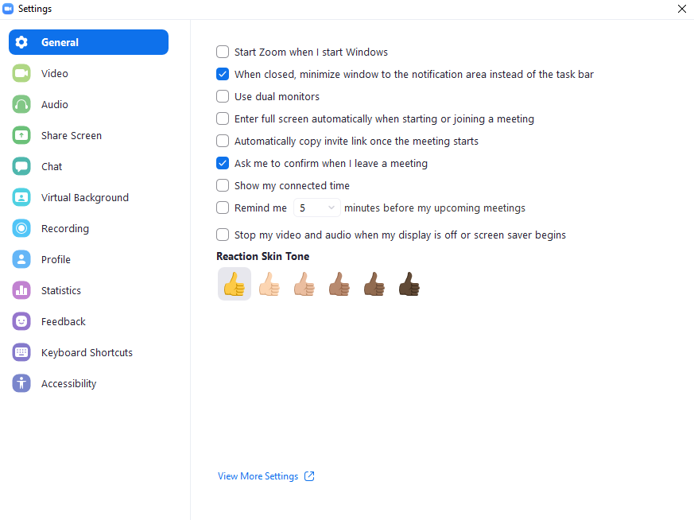
Settings through desktop app
Settings
Click Here for More Settings
Notes:
Using the desktop app, click on the radial below you photo. You have many setting options inside of this area, but to see the same settings as I just presented, click “View More Settings” on the bottom of the General tab.

Slide 17
Captions for Zoom Recording
How to Turn on Captions for Zoom Recording

Slide 18
What is the difference between a Zoom meeting and a Zoom webinar?
“A standard Zoom meeting is fully interactive and allows all participants the ability to see, speak, hear, and screen-share with each other.
A Zoom webinar is a view-only platform where the attendees cannot see each other, and the Host cannot see the attendees. A webinar has registration, reporting and in-meeting chat for attendees.”
(Source: https://impact.extension.org/zoom/)

Slide 19
Privileges of Co-Hosts in Zoom meetings
The co-host feature allows the host to share hosting privileges with another user, allowing the co-host to manage the administrative side of the meeting, such as managing participants or starting/stopping the recording. The host must assign a co-host. There is no limitation on the number of co-hosts you can have in a meeting or webinar.
Co-hosts do not have access to the following controls as they are only available as host controls in a meeting:
Start closed captioning and assign someone or a third-party to provide closed captioning
Start live streaming
End meeting for all participants
Make another participant a co-host
Start breakout rooms or move participants from one breakout room to another
Start waiting room (co-hosts can place participants in waiting room or admit/remove participants from the waiting room)
Co-hosts also cannot start a meeting. If a host needs someone else to be able to start the meeting, they can assign an alternative host.
Notes:
Source: https://support.zoom.us/hc/en-us/articles/206330935-Enabling-and-adding-a-co-host

Slide 20
Enabling a Co-Host - Members
To enable the Co-host feature for all members of your organization:
1. Sign into the Zoom web portal as an administrator with the privilege to edit Account settings, and click Account Settings.
2. Navigate to the Co-host option on the Meeting tab and verify that the setting is enabled.
If the setting is disabled, click the Status toggle to enable it. If a verification dialog displays, choose Turn On to verify the change.
3. (Optional) If you want to make this setting mandatory for all users in your account, click the lock icon, and then click Lock to confirm the setting.

Slide 21
alternative host
Alternative hosts can start a meeting on the host’s behalf
They are unable to schedule on the behalf of the host
If the host needs assistance, they can assign a co-host during the meeting

Slide 22
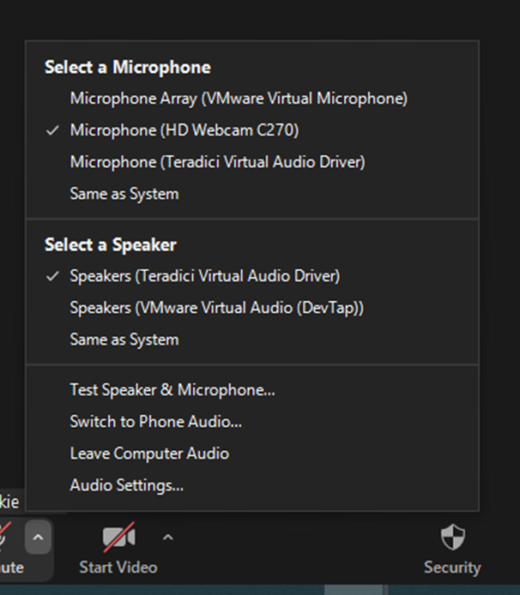
Some helpful tips
Set up your account and have adequate time to play with your settings prior to the first meeting
If you connect personal headphones with microphone to the thin client at CF, you will need to select your preferred device(s) as your sources for hearing and speaking during the presentation (See the screen snipping to the right)
Dress professionally, even below the camera view
Prepare for Zoom meetings as you would for an actual meeting
Smile
Breathe

Slide 23
Some helpful tips (con’t)
Check your surroundings before your meeting
Ensure you do not have animals, significant others, or children that could interrupt your meeting
If using a virtual background, take it for a test drive before you commit during a meeting
VMWare does not work well with Zoom’s Smart Screen feature or unchecking “Green Screen”
Have a set of headphones/ear buds with a microphone to limit background noise. Try them out prior to your meeting to ensure you have the proper drivers installed
On campus, the HD option does not work
If you have an issue with web cameras on campus, stop the video, cover the lens with your hand, and restart the video
Always check your equipment prior to allowing attendees to enter the meeting area

Slide 24
Additional helpers and insights
Keyboard Shortcuts and Hot Links for Zoom
Zoom Meetings YouTube Channel
Zoom Meeting With Example of a Breakout Group
Zoom Virtual Background Without Green Screen

Slide 25
Thank you for your time and helping change the lives of our students!
Please feel free to ask any questions you may have, even after the presentation.
Smokie West ~ wests@cf.edu

